Slide 1
Predict if you have corona by Machine Learning

Slide 2
Objective: -
The test kit of corona virus is really expensive & available in very low numbers. Right now, we don’t have any other way to know if you are infected by coronavirus or not.
Here Machine learning will be used to predict if someone could be infected by coronavirus or not, by analyzing other medical symptoms of that person.

Slide 3
How to implement?
To predict if a person could be affected by Coronavirus or not, a Machine Learning model will be created.
Data should be fed to the model, to train the model about the symptoms & the probable relation of them with the covid-19 infection.
Only then it can be predicted if someone could be infected by COVID-19 or not by analyzing his/her other medical symptoms.

Slide 4
Where to get the Data?
The data of COVID-19 was released in Kaggle about 10th March in this year.
but the data is not in a suitable form of dataset to be fed in ML model.
So, the raw metadata was analyzed & the abstract from each and every instances of the data was analyzed by NLP (Natural Language Processing) to extract information that whether that instance of the data was about COVID-19 infection or not.
For both the cases-
• if the instance of data is about COVID-19 infected
or
• if the data was about COVID-19 not infected
the symptoms are analyzed by NLP & SCAPY module of python.

Slide 5
Then how do we get the dataset?
All the data would be extracted to create a separate dataset which will be suitable to fit Machine Learning model on it.
This dataset would be fed to the ML model to predict if someone is affected by COVID-19 or not if he/she has some specific symptoms.

Slide 6
Is this actually feasible?
This will help this people to know that if he/she could be infected by COVID-19 before going for the actual test which is time taken & costlier.
It will decrease the panic among those people who are tensed about this virus infection but can’t get to be tested right now.
It will also warn those if someone is not cautious about this virus infection but actually have high chance to be infected.

Slide 7



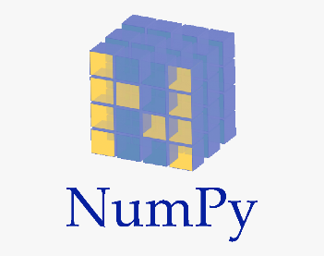
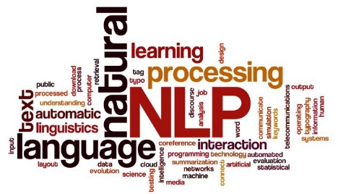

Technology Used

Slide 8
Thank You
-Created by Pritimoy Sarkar

